Slide 1
Optimizing Dillard’s Expansion:
Using Sales Data and Consulting-Backed Estimation to Select the Next Local Store Location(s)
MLDS 400 Group 5
Xiyi Lin, Omar Shatrat, Fanqi Song, Tianyu Wu

Slide 2
Outline
Overview of Dillard’s
Motivation & Business Question
Our Data Science Pipeline
Data Cleansing and Exploratory Data Analysis (EDA)
Feature Selection and Engineering
Model Development and Selection
Recommendation - Decision Region
ROI Spreadsheet and Analysis

Slide 3

Overview of Dillard’s
American department store chain
Found in 1938
Operated over 300 Dillard’s locations as of 2005
Online Store at Dillars.com complements the physical retail spaces

Slide 4
Motivation & Business Question
Identify promising location(s) for Dillard’s next local store by leveraging sales data and consulting-backed estimation
Why? Poor store location choices directly impact a store’s long-term success and lead to operational inefficiencies affecting overall profitability
Our Goal: Minimize risks in new store opening and ensure investments are directed for optimal returns

Slide 5
Our Data Science Pipeline
Data Cleansing and Preparation
Exploratory Data Analysis (EDA)
Feature Selection and Engineering
Recommendation - Decision Region
Visualization and Reporting
Model Development and Evaluation

Slide 6
Data Science Pipeline - Data Cleansing
Missing values Imputation
Typically in cost, retail price, sale price, and AMT columns
Fill by the mathematical relationship: AMT = sale price * quantity
Fill by average value: Cost <- groupby(‘SKU’)[‘COST’].transform(‘mean’)
Capture temporal patterns
Fetch ‘YYYY-MM’ via Sale Date column
Geo-encoding
using city and state columns to generate latitude & longitude columns

Slide 7
Data Science Pipeline - Data Preparation
Tables of Interest
Ensure a comprehensive view of transaction, SKU, and store information
trnsact
skstinfo
strinfo
Geo-
encoding
Sale Date
Sale Price
Stype
Quantity
AMT
Cost
Retail Price
City Name
State Name
Longitude
Latitude
Merged by SKU and Store columns

Slide 8
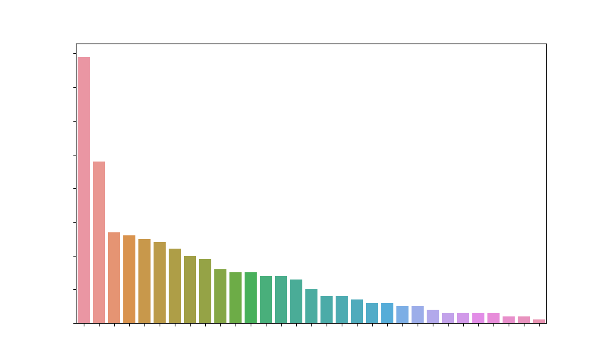
EDA: Store Location Distribution
Number of Stores
Top 5 by States | Top 5 by Cities
Texas (TX) | Little Rock (AR)
Florida (FL) | Gilbert (AZ)
Arkansas (AR) | Olathe (KS)
Arizona (AZ) | San Antonio (TX)
Ohio (OH) | Houston (TX)
Stores across 30 states and 299 cities
Plausible Reason:
Heightened consumer demand and meticulous strategic planning

Slide 9
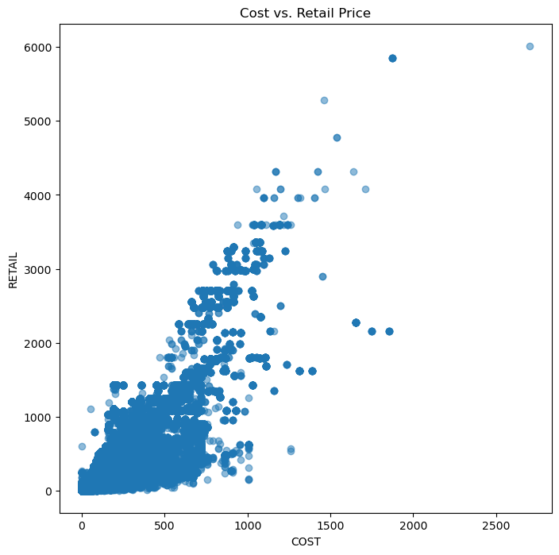
EDA: Cost and Retail Price
A well-balanced distribution: moderate cost and retail price values
Correlation (0.896): higher product costs correlate with elevated retail prices
Insight: Having formulated effective pricing strategies

Slide 10
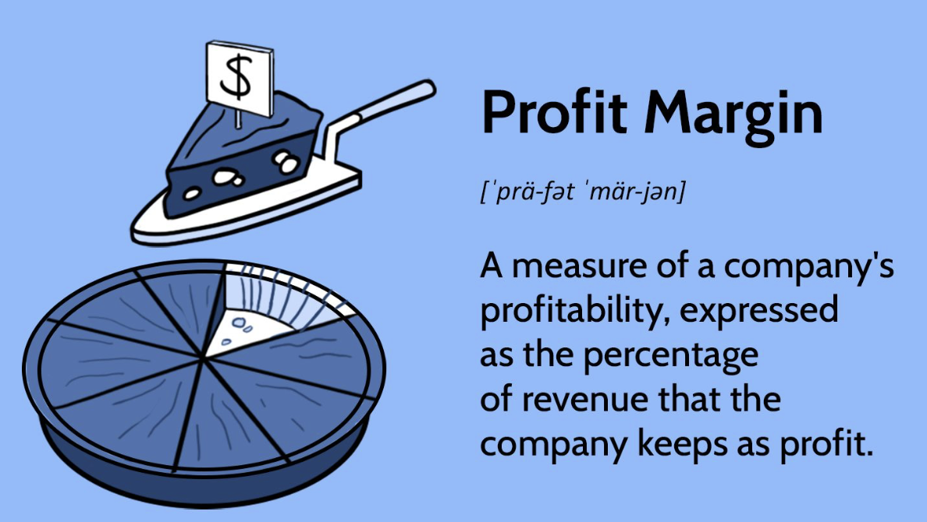
EDA: Profit Margins (PM)
A metric that delineates the disparity between retail price and cost
PM = (Retail Price - Cost) / Cost
Insight: a significant store presence, efficient cost management, and well-executed pricing strategies
Top 5 Cities with the highest PM
Arkansas (AR)
Oklahoma (OK)
Ohio (OH)
Texas (TX)
Tennessee (TN)

Slide 11

Feature Selection and Engineering: KPIs
Average Cost of Goods Sold (COGS) per Item Sold
Indicating profitability by balancing sales with production costs. Lower values signify efficient sales generation with minimized production expenses.
MoM Growth
Calculating the percentage change in gross profit from the previous month. A positive MoM Gross Profit Growth indicates an increase in gross profit.
Return Percentage
Expressing the proportion of sales revenue returned to the business as product returns. A higher percentage implies a larger share of sales being returned.

Slide 12
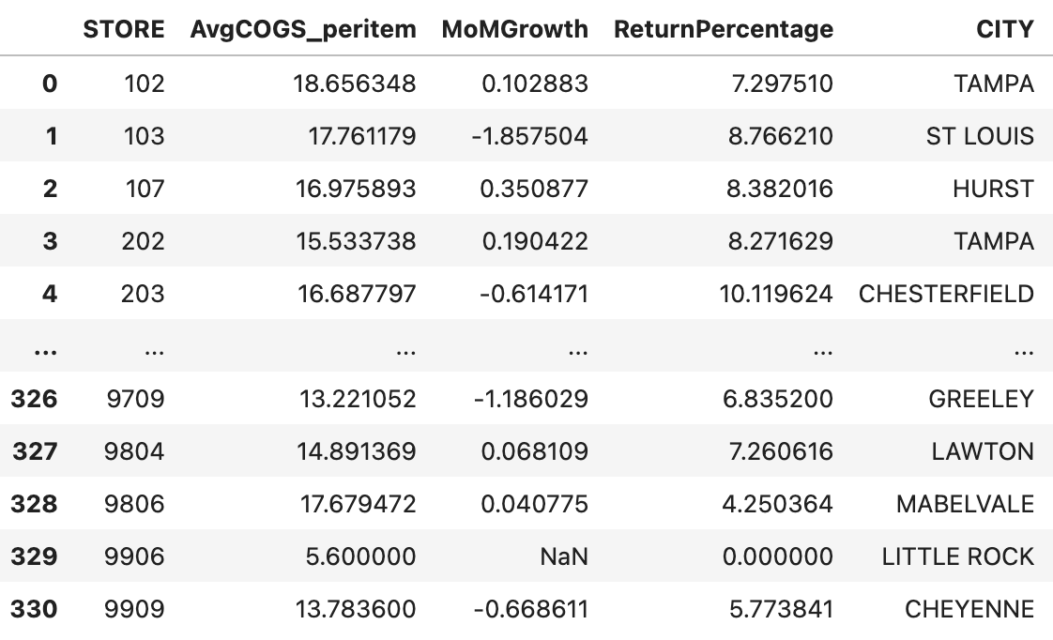
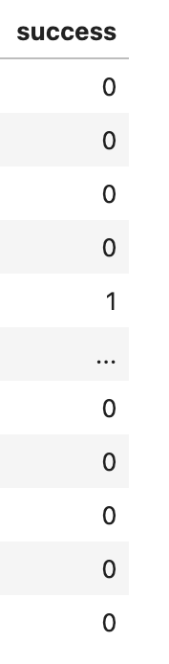
Feature Engineering: KPIs
how?
Demo of KPI Values

Slide 13
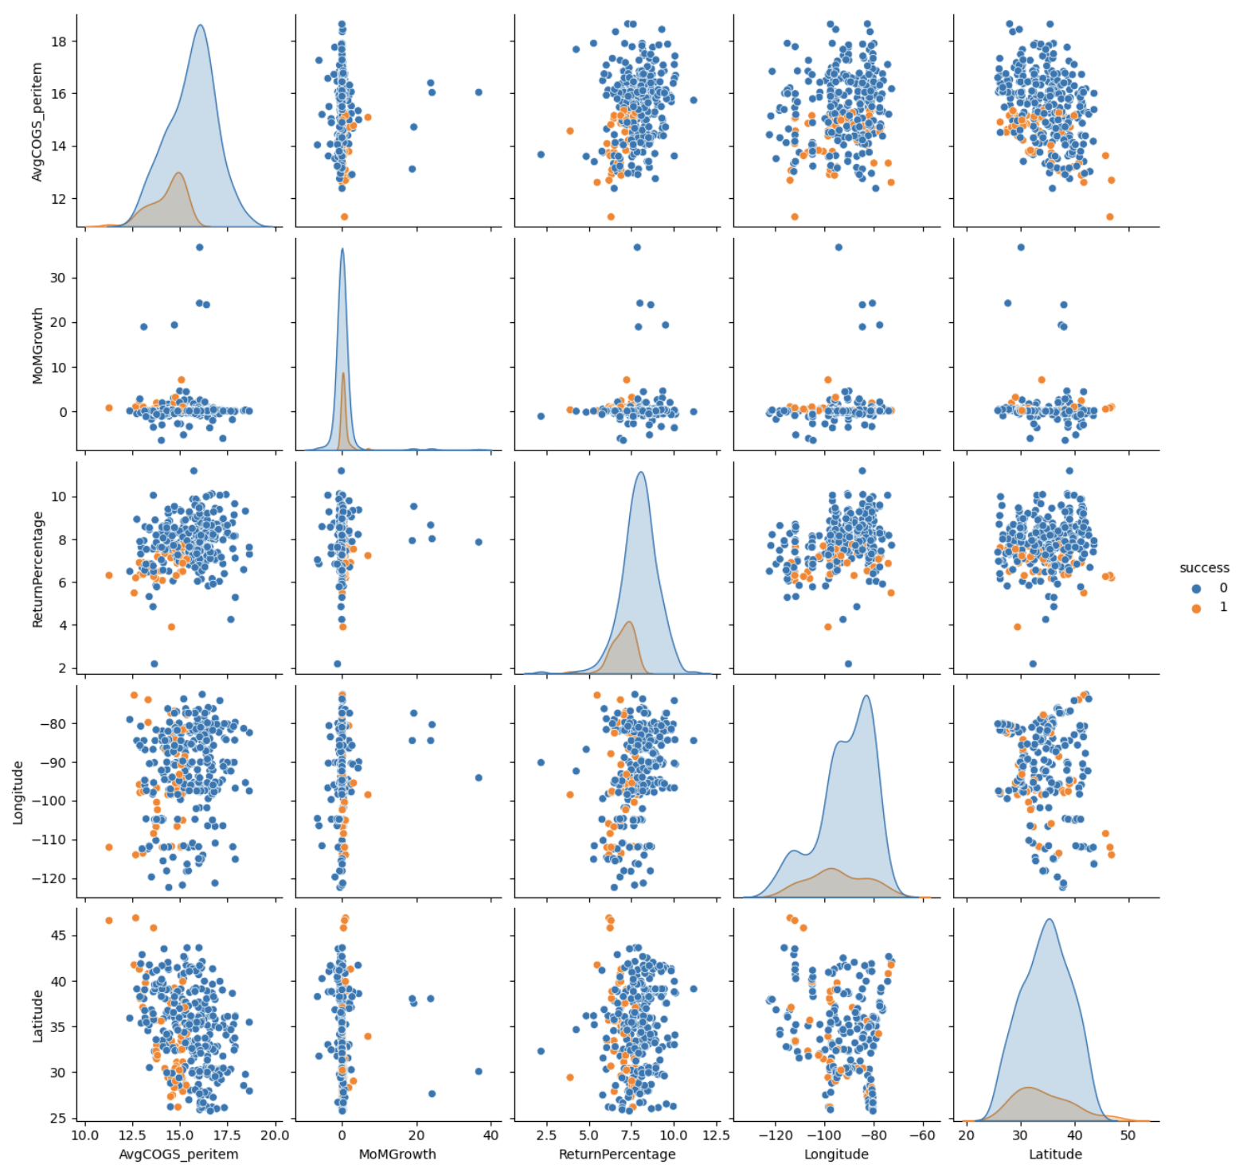
Feature Engineering Visualization
But … how to define success?
Store is successful if and only if:
MoM Growth is among the high-spread interval, i.e., above the median.
Average Cost of Goods Sold (COGS) per Item Sold and Return Percentage is among the low-spread interval, i.e. below the median.
Pairplot of newly created features (KPIs)

Slide 14
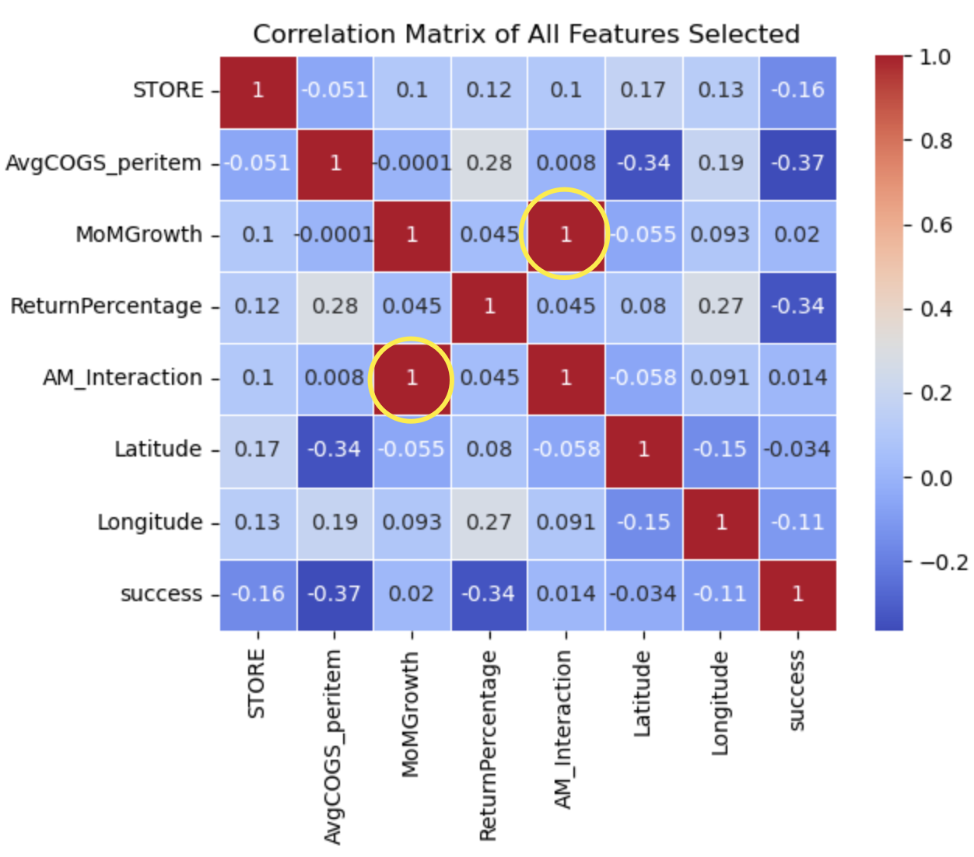
Attention!
Our Decision: Drop Average Cost of Goods Sold (COGS) per Item Sold feature when developing models
how?
Irregular Correlation Heatmap

Slide 15
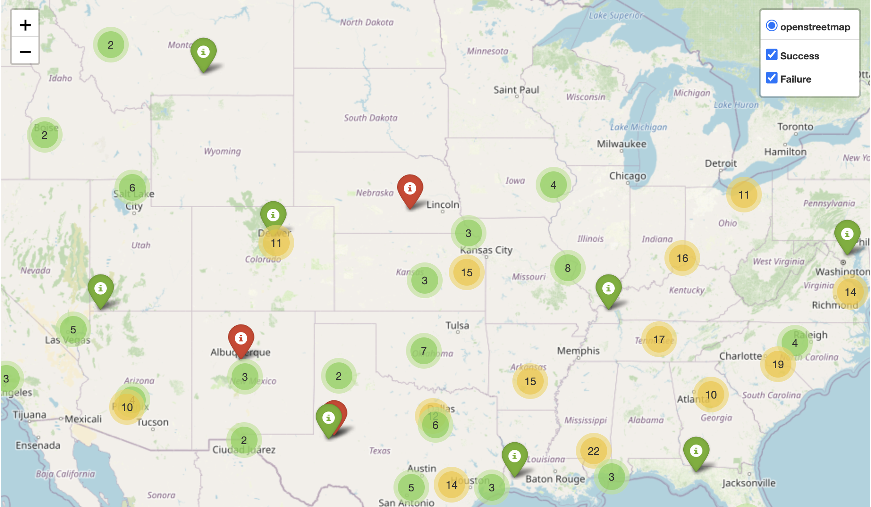
Successful Stores over the States
Now the success rate distribution is hence calculated as follows:
Successful | Not Successful
15.3% | 84.7%
=>
The ratio between successful and unsuccessful stores appears to be reasonable
Demo of Store Success Distribution On Map

Slide 16
Model Development
MoM Growth
Common Classification Algorithms
Return Percentage
Metrics for Model Comparison and Selection
Latitude
longitude

Slide 17
Model Comparison & Selection
Models | Metrics
 | Accuracy | Macro Precision | Macro Recall | Macro F-1 Score
Logistic Regression | 0.76 | 0.64 | 0.77 | 0.65
Decision Tree | 0.89 | 0.78 | 0.75 | 0.76
Random Forest | 0.91 | 0.80 | 0.85 | 0.82
SVM | 0.65 | 0.56 | 0.61 | 0.54
K-NN | 0.70 | 0.62 | 0.73 | 0.60
=>
We will then use Random Forest model to select the promising location(s) for Dillard’s next local store.

Slide 18
Recommendation - Decision Region
Based on consulting-backed estimations, our model shows that COLUMBIA and PHOENIX emerge as the most promising locations among the five of interest below
 | MoMGrowth | ReturnPercentage | Latitude | Longitude | CITY | Success
1 | 20.4012 | 0.002 | 35.395 | -95.814 | OKLAHOMA | 0
2 | 0.8123 | 4.28038 | 39.204 | -76.690 | COLUMBIA | 1
3 | -0.12595 | 10.2903 | 32.380 | -86.312 | MONTGOMERY | 0
4 | 0.067734 | 6.32 | 33.415 | -111.835 | MESA | 0
5 | 0.4729 | 5.2039 | 33.451 | -112.016 | PHOENIX | 1

Slide 19
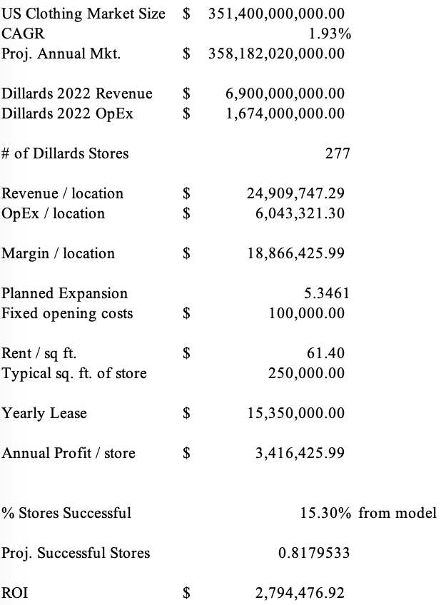
ROI Spreadsheet

Slide 20
ROI Analysis
The market opportunity for Dillard’s is significant:
Total Market for Clothing: $351.4bn
Annual Avg. Growth: 1.93%
Being able to assess which stores will be strong performers can help Dillard’s cut down on fixed costs and lease expenses.
If Dillard’s grows at a similar pace with the market, ROIs in the neighborhood of ~$2.8bn are attainable.

Slide 21
Thanks for Listening!

